Slide 1

Introduction to Image Classification using Convolutional Neural Networks
Module 6 - Vision Models

Slide 2
Table of contents
01
02
03
04
What is a Convolutional Neural Network (CNN)?
Comparing ANN vs CNN for Image Classification
Layers of CNN
A Classical CNN Architecture

Slide 3
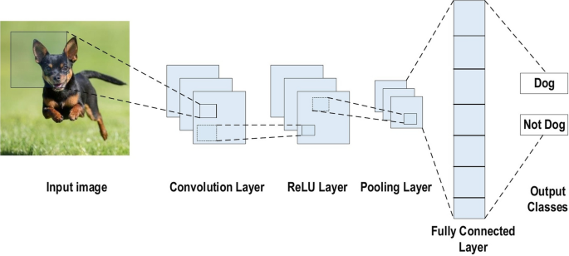
What is a Convolutional Neural Network (CNN)?
A Convolutional Neural Network (CNN), also known as ConvNet, is a specialized type of deep learning algorithm mainly designed for tasks like object recognition, including image classification, detection, and segmentation.
CNNs are employed in a variety of practical scenarios, such as autonomous vehicles, security camera systems, and others.

Slide 4
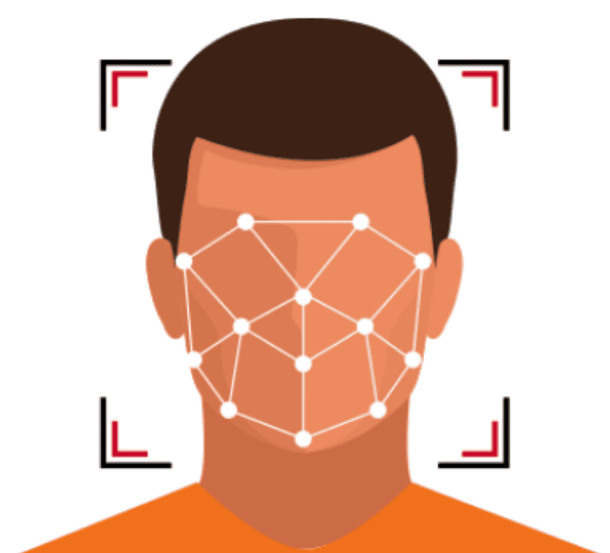
Applications of CNN
Face Recognition Applications - Social Media, Identification, and Surveillance
Medical Image Computing – Predictive Analytics, Healthcare Data Science
Image Classification – Search Engines, Social Media, Recommender Systems

Slide 5
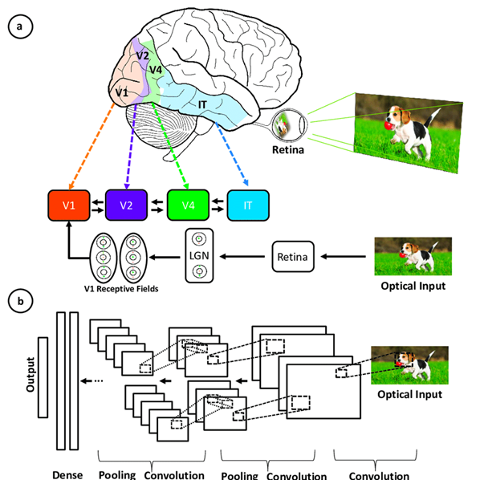
Inspiration Behind CNN
Convolutional neural networks were inspired by the layered architecture of the human visual cortex.

Slide 6
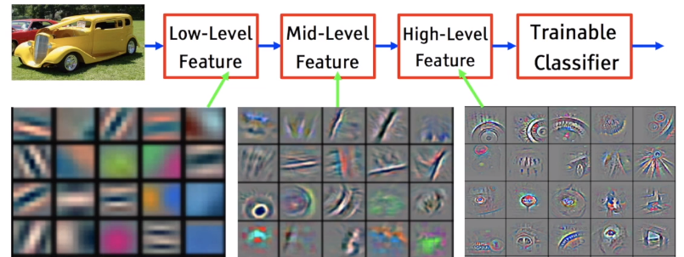
Importance of CNNs
CNNs autonomously extract features at a large scale, bypassing the need for manual feature engineering and thereby enhancing efficiency.
The convolutional layers enables the CNNs to identify and extract patterns and features from data irrespective of variations in position, orientation, scale, or translation.
Notes:
A variety of pre-trained CNN architectures, including VGG-16, ResNet50, Inceptionv3, and EfficientNet, have demonstrated top-tier performance. These models can be adapted to new tasks with relatively little data through a process known as fine-tuning.

Slide 7
Comparing ANN vs CNN for Image Classification
Neural Networks
Convolutional Neural Networks
Input Data | Treats input data as a flat vector. | Utilizes spatial relationships in input data through convolutional layers.
Architecture | Typically consists of fully connected layers. | Contains convolutional layers followed by pooling layers and fully connected layers.
Parameter Sharing | Does not share parameters across different parts of the image. | Shares parameters through convolutional filters, allowing for feature reuse.
Feature Extraction | Requires manual feature engineering. | Automatically learns features from the input data.
Performance on Images | Less effective in capturing spatial dependencies and local patterns in images. | Highly effective in capturing spatial dependencies and local patterns in images.
Computational Efficiency | Less computationally efficient due to fully connected layers. | More computationally efficient, especially for large images, due to parameter sharing.

Slide 8

CNN Architecture
Convolutional Neural Network consists of multiple layers like the input layer, Convolutional layer, Pooling layer, and fully connected layers.
Simple CNN architecture
The Convolutional layer applies filters to the input image to extract features, the Pooling layer down-samples the image to reduce computation, and the fully connected layer makes the final prediction.

Slide 9
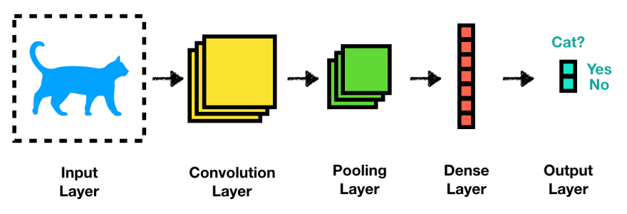
Layers of CNN
Convolutional Layers
Pooling layers
Flattening layer
Fully connected layers
Output layer
Notes:
Convolutional layers
Rectified Linear Unit (ReLU for short)
Pooling layers
Fully connected layers

Slide 10
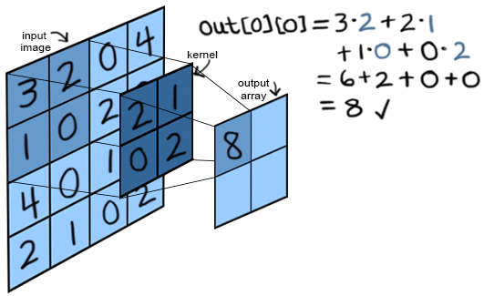
Convolution Layers
This is the first building block of a CNN, it applies a sliding window function to a matrix of pixels representing an image.
The sliding function applied to the matrix is called kernel or filter.
In the convolution layer, several filters of equal size are applied, and each filter is used to recognize a specific pattern from the image, such as the curves, the edges, the whole shape and more.
Notes:
In the convolution layer, several filters of equal size are applied, and each filter is used to recognize a specific pattern from the image, such as the curving of the digits, the edges, the whole shape of the digits, and more.

Slide 11

Convolution Layers
The kernels move over the image like a mini magnifying glass that looks for specific patterns in the photo, like lines, curves, or shapes.

Slide 12
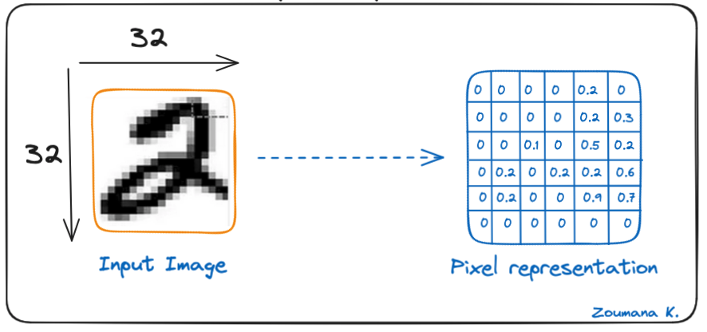
Convolution Layers (cont’d)
Let’s consider the kernel used for the convolution. It is a matrix with a dimension of 3x3.
The weights of each element of the kernel is represented in the grid. Zero weights are represented in the black grids and ones in the white grid.
Do we have to manually find these weights?
In real life, the weights of the kernels are determined during the training process of the neural network.
Notes:
Another name associated with the kernel in the literature is feature detector because the weights can be fine-tuned to detect specific features in the input image.
For instance:
Averaging neighboring pixels kernel can be used to blur the input image.
Subtracting neighboring kernel is used to perform edge detection.
The more convolution layers the network has, the better the layer is at detecting more abstract features.

Slide 13
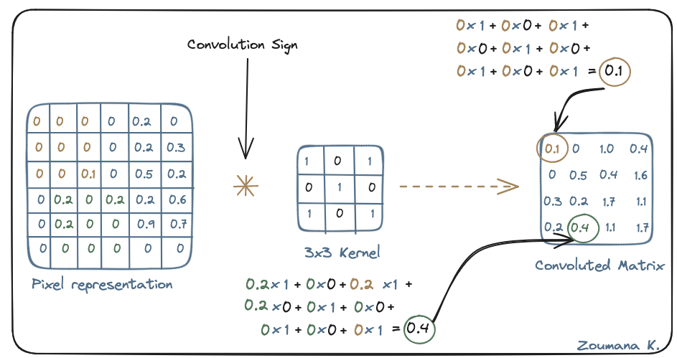
Convolution Layers (cont’d)
Using these two matrices (weights and pixels), we can perform the convolution operation by applying the dot product, and work as follows:
Apply the kernel matrix from the top-left corner to the right.
Perform element-wise multiplication.
Sum the values of the products.
The resulting value corresponds to the first value (top-left corner) in the convoluted matrix.
Move the kernel down with respect to the size of the sliding window.
Repeat steps 1 to 5 until the image matrix is fully covered.

Slide 14
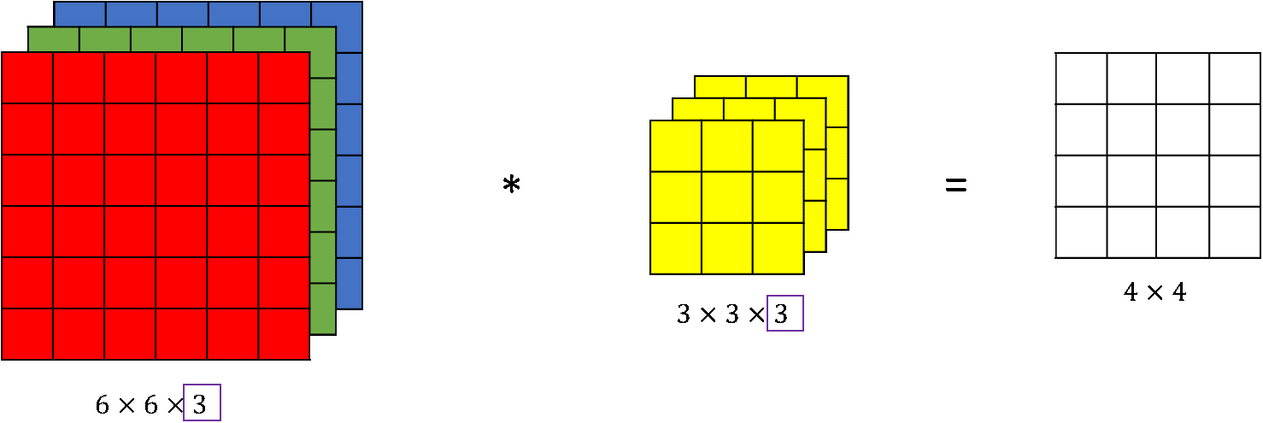
Convolution Layer: Example
Imagine you have an image. It can be represented as a cuboid having its length, width (dimension of the image), and height (i.e the channel as images generally have red, green, and blue channels).
Now imagine taking a small patch of this image and running a mini magnifier, called a filter or kernel on it, with say, K outputs and representing them vertically.
Now slide that magnifier across the whole image, as a result, we will get another image with different widths, heights, and depths.
If the patch size is the same as that of the image it will be a regular neural network. Because of this small patch, we have fewer weights.
Instead of just R, G, and B channels now we have more channels but lesser width and height.

Slide 15
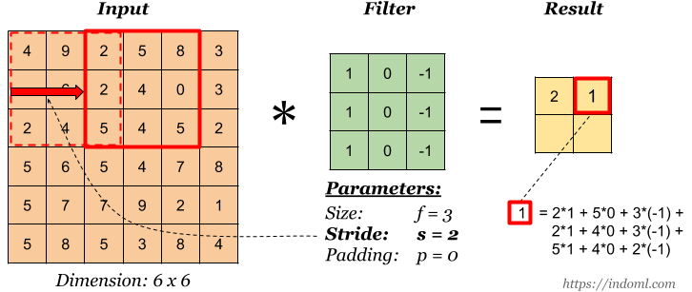
Convolution Layer: Example (cont’d)
Now let’s talk about the mathematics in the convolution process.
Convolution layers consist of a filters (or kernels) having small widths and heights and the same depth as that of input volume (3 if the input layer is image input).
A Convolution on an image with dimensions 34x34x3. The possible size of filters can be axax3, where ‘a’ can be anything like 3, 5, or 7 but smaller as compared to the image dimension.
During the forward pass, each Kernel slide across the whole input volume step by step where each step is called stride (which can have a value of 2, 3, or even 4 for high-dimensional images) and compute the dot product between the kernel weights and patch from input volume.

Slide 16
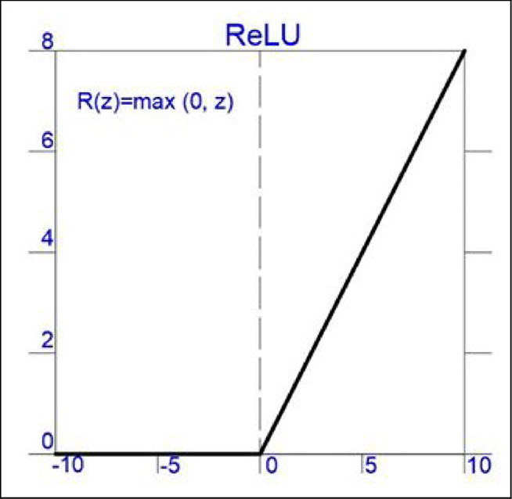

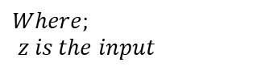
CNN Activation Function
A ReLU activation function is applied after each convolution operation.
This function helps the network learn non-linear relationships between the features in the image, hence making the network more robust for identifying different patterns.
It also helps to mitigate the vanishing gradient problems.
$$R\left(z\right)=\max{(0, z)}$$
$$Where; \\ z is the input$$

Slide 17
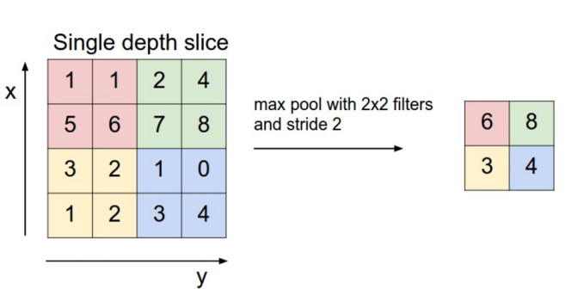
Pooling Layer
The Goal of the pooling layer is to pull the most significant features from the convoluted matrix.
This is done by applying some aggregation operations, which reduce the dimension of the feature map (convoluted matrix), reducing the memory used while training the network.
Pooling is also relevant for mitigating overfitting.

Slide 18
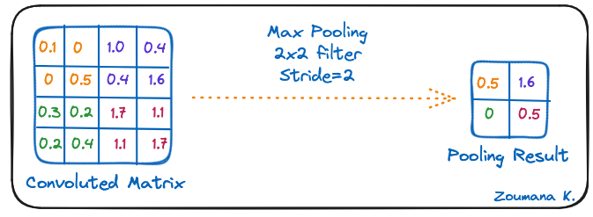
Pooling Layer (cont’d)
The most common aggregation functions that can be applied are:
Max pooling: which is the maximum value of the feature map.
Sum pooling: corresponds to the sum of all the values of the feature map.
Average pooling: is the average of all the values.

Slide 19
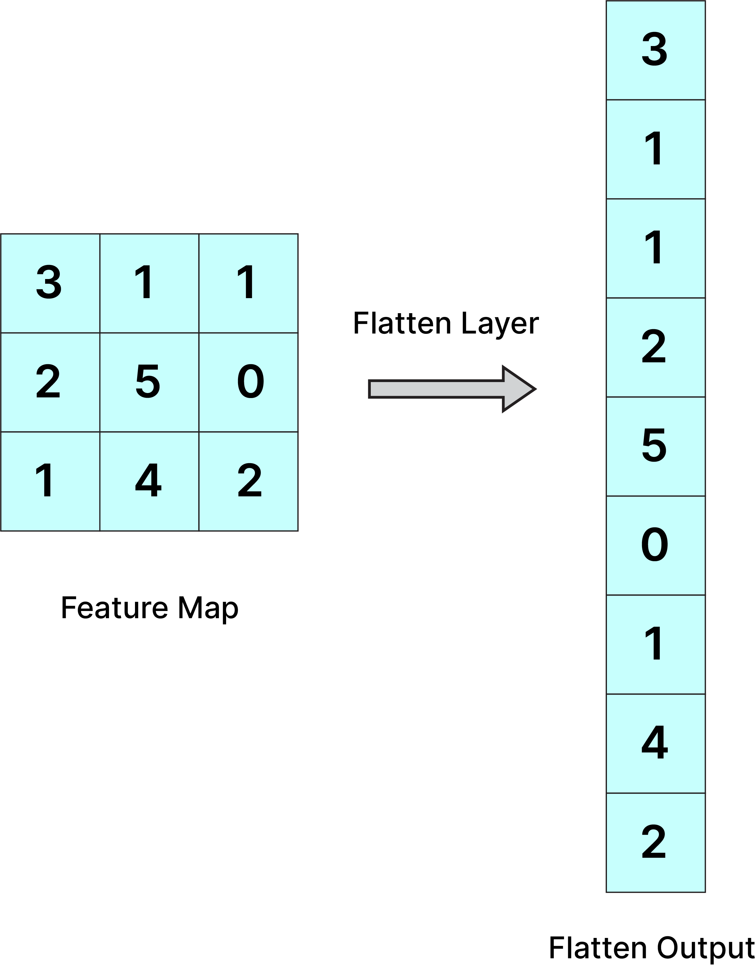
Flattening Layer
The resulting feature maps are flattened into a one-dimensional vector after the convolution and pooling layers.
Feature map after the Flattening layer can be passed into the Fully Connected Layer for categorization or regression.

Slide 20
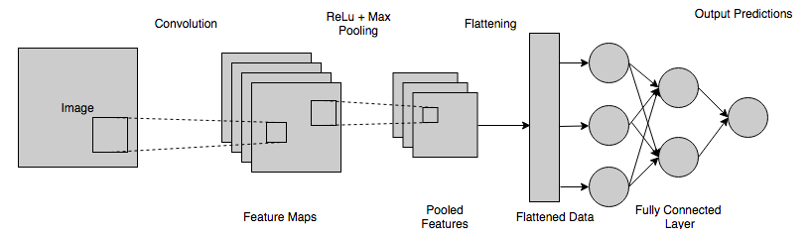
Fully connected layers
These layers are in the last layer of the convolutional neural network, and their inputs correspond to the flattened one-dimensional matrix generated by the last pooling layer.
It takes the input from the previous layer and computes the final classification or regression task.

Slide 21
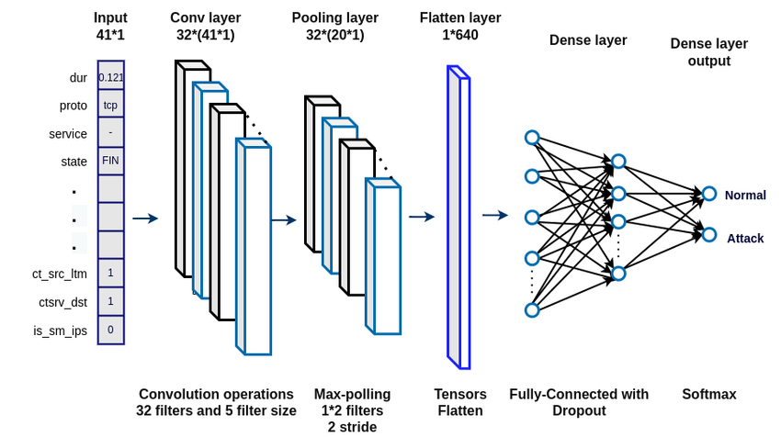
Output Layer
The output from the fully connected layers is then fed into a logistic function for classification tasks like sigmoid or SoftMax depending on whether the target column is binary, multi-class or multi-label.

Slide 22
Activity
Now let’s transition to Google-Colab for hands-on coding practice.

Slide 23

A Classical CNN Architecture
The first hidden layer is a Convolutional layer call Convolution2D. It has 32 feature maps with size 5×5. This is also the input layer.
Next is the pooling layer that takes the maximum value called MaxPooling2D. In this model, it is configured as a 2×2 pool size.
The fifth layer is the flattened layer that converts the 2D matrix data into a vector called Flatten. It allows the output to be fully processed by a standard fully connected layer.
Next, Fully connected layer Dense with 128 neurons.
Finally, the output layer has 10 neurons for the 10 classes and a SoftMax activation function.
model=Sequential()
model.add(Conv2D(32,5,5, padding='same',input_shape=(1,28,28), activation='relu'))
model.add(MaxPooling2D(pool_size=(2,2), padding='same'))
model.add(Dropout(0.2))
model.add(Flatten())
model.add(Dense(128, activation='relu'))
model.add(Dense(10, activation='softmax'))
model.compile(loss='categorical_crossentropy’, optimizer='adam', metrics=['accuracy'])

Slide 24
Thanks!

